Slide 1
LayerZero - The Journey of a Cross-Chain Message (V2) Universal Postal Service of Blockchains
How a LayerZero message travels: send → verify → commit → deliver
Nagu Thogiti
Notes:
Open with the postal metaphor and the promise: secure, permissionless cross-chain messaging in under 15 minutes.

Slide 2
Overview
Short presentation of LayerZero's cross-chain message journey
Structured like slides with accompanying speaker notes
Notes:
Set expectations: high-level, accurate, on-time. Point to images for mental model.

Slide 3
Learning Intentions & Success Criteria
Learning Intentions
Understand LayerZero V2’s secure cross-chain flow
Trace send → verify → commit → deliver
Know roles: Endpoint, Libraries, DVNs, Executors, OApp
Success Criteria
Narrate the journey like a parcel abroad
Explain who does what and why it’s permissionless
Choose sane options and DVN quorums
Notes:
Keep it crisp—what they’ll walk away with.

Slide 4
LayerZero — A Universal Postal Service for Blockchains
Chains = countries (VM, consensus, gas)
Endpoint V2 = post office (per chain)
DVNs = independent inspectors (off-chain)
Quorum proof = customs stamp bundle (on-chain)
Executor/anyone = courier (last-mile delivery)
Notes:
Metaphor anchors the rest of the talk.

Slide 5
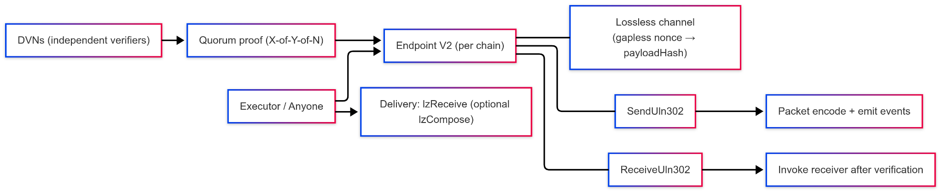
The Cast (LayerZero V2 Components)
Notes:
Name each role. Emphasize immutable endpoint + lossless channel; send/receive libraries; DVNs; permissionless executors; OApp peers.

Slide 6
Components (at a glance)
Endpoint V2 (immutable)
Lossless channel: gapless nonces + payloadHash; audit-friendly
Message Libraries (SendUln302 / ReceiveUln302)
Standardize packets; route options to off-chain executors
Message Send Library
Encode outbound packet; quote fees from options; emit events for DVNs/executors
Message Receive Library
Decode inbound packet; enforce DVN quorum; commit verified nonce→payloadHash
DVNs
Independent verifiers; you choose quorum (X-of-Y-of-N)
Executor / Anyone
Funds gas; triggers delivery to your app
Your OApp
Knows endpoint + trusted peers (EIDs); implements _lzReceive(...)
Notes:
This is what devs actually interact with: _lzSend and _lzReceive. Everything else is plumbing.

Slide 7
The Message Journey (Source → Destination)

Slide 8
Step 1 — Prepare & Post (Source)
Sender OApp calls Endpoint.send(MessagingParams)
Endpoint stamps GUID + increments pathway nonce
Send library encodes packet; emits events (DVNs/executors watch)
GUID = global tracking, Nonce = per-pathway ordering
Notes:
Highlight separation of message vs options; exactly-once starts with channel bookkeeping.

Slide 9
Step 2 — Customs Inspection (DVNs, off-chain)
DVNs independently observe the source chain
Each attests the payloadHash
When quorum is met, a quorum proof exists
Notes:
Nobody calls DVNs; they watch and attest.

Slide 10
Step 3 — Customs Check-in (Destination)
Anyone submits the quorum proof to Endpoint to `commitVerified`
Receive library enforces DVN config and thresholds
Endpoint records verified nonce → payloadHash in lossless channel
Status: Verified (eligible for delivery)
Notes:
Permissionless commit is one of the censorship-resistance points.

Slide 11
Step 4 — Last-Mile Delivery (Destination)
Anyone funds gas/value to deliver
Endpoint invokes receiver’s `lzReceive(...)` → your `_lzReceive(...)`
If options included follow-ups, Endpoint later calls `lzCompose(...)`
Status: Delivered (app logic executed)
Notes:
Executors are replaceable; delivery is permissionless.

Slide 12
Step 5 — Ordering
Default (lazy): failed n doesn’t block n+1 once both are verified
Strict FIFO (opt-in): ordered execution in options holds n+1 until n executes
Notes:
Choose strict only when business logic demands it.

Slide 13
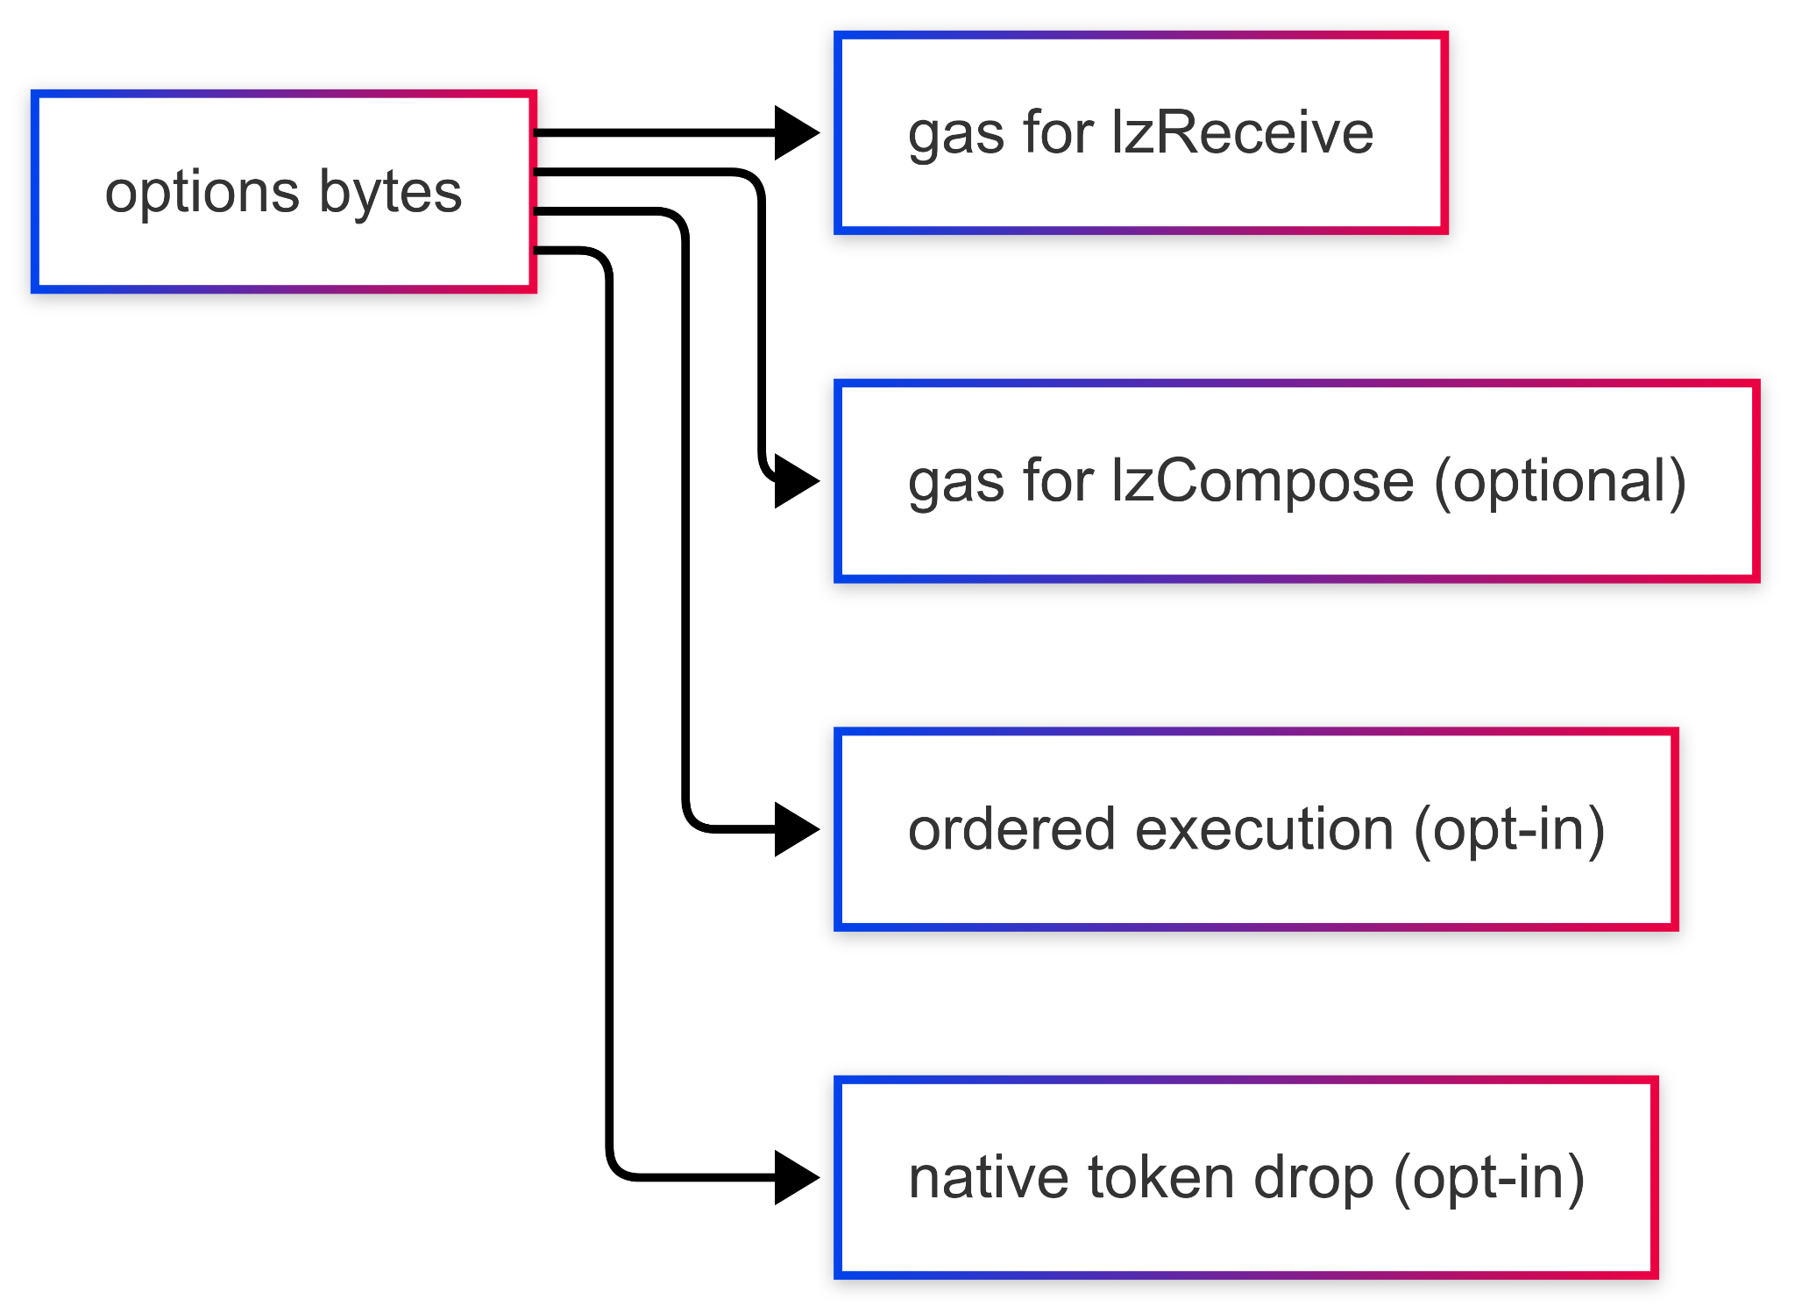
Options = Your Handling Instructions
Notes:
Options steer gas for lzReceive/lzCompose, ordered execution, and native drop. Apps can enforce minimums; users can top up.

Slide 14
Properties (why the LayerZero network works)
Exactly-once per pathway
Gapless nonces + payloadHash in lossless channel; clean audit trail
Censorship-resistant
DVN quorum + permissionless commitVerified and delivery
Operationally resilient
Executors are replaceable; anyone can retry with more gas/options
Simple control surface
`options` tunes gas, ordering, native drops, compose
Notes:
Say all four in one sweep; these are the guarantees.

Slide 15
Receiver Gatekeeping (who can ring the doorbell?)
function lzReceive( Origin calldata _origin, bytes32 _guid, bytes calldata _message, address _executor, bytes calldata _extraData ) public payable { if (address(endpoint) != msg.sender) revert OnlyEndpoint(msg.sender); if (_getPeerOrRevert(_origin.srcEid) != _origin.sender) revert OnlyPeer(_origin.srcEid, _origin.sender); _lzReceive(_origin, _guid, _message, _executor, _extraData); }
Notes:
Only the Endpoint can invoke; only messages from trusted peers are accepted. Then your app logic runs.

Slide 16
Quick FAQ
Is there a relayer?
In V2 it’s split: DVNs verify; Executors (or anyone) deliver.
Who contacts DVNs?
No one—DVNs watch; a third party submits the quorum proof on the destination chain.
Why permissionless delivery?
Removes last-mile chokepoints; anyone can retry.
When to enable strict ordering?
When business logic needs FIFO; default lazy aids liveness.
Notes:
Invite 1–2 questions; timebox answers.

Slide 17
References
LayerZero Docs — https://docs.layerzero.network/v2
Sample Examples — https://github.com/LayerZero-Labs/devtools/tree/main/examples
Notes:
Point to docs and examples for deeper dives.

Slide 18
Thank you
https://layerzero.network/

